Slide 1
MassCEC Solar Costs Comparison Tool
File created on: 9/17/2024 9:02:03 PM

Slide 2
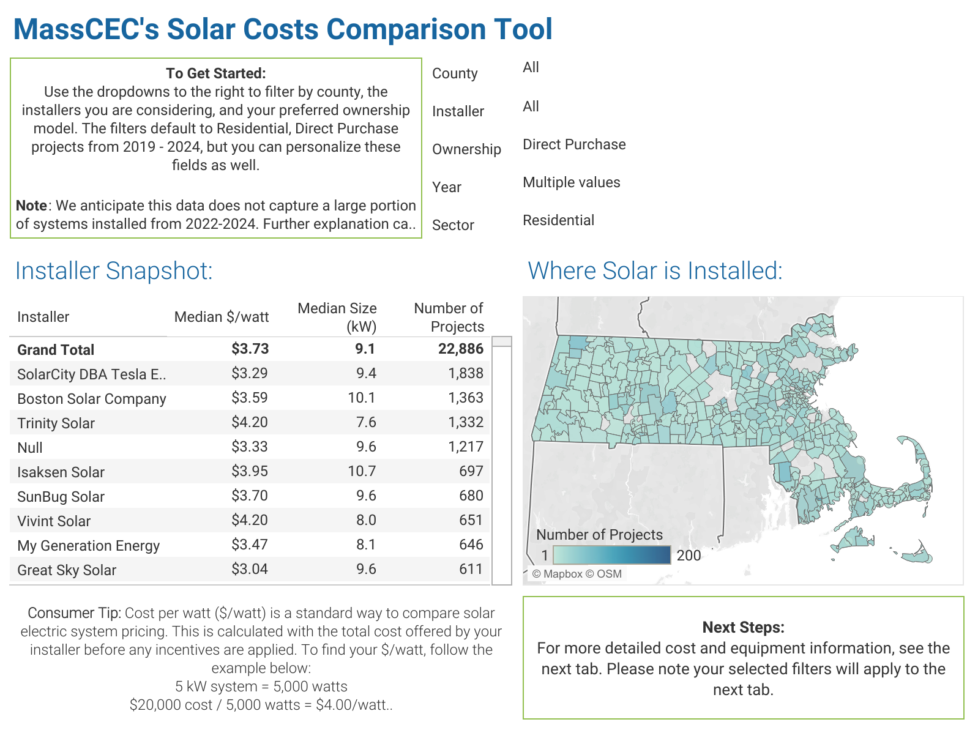

Slide 3
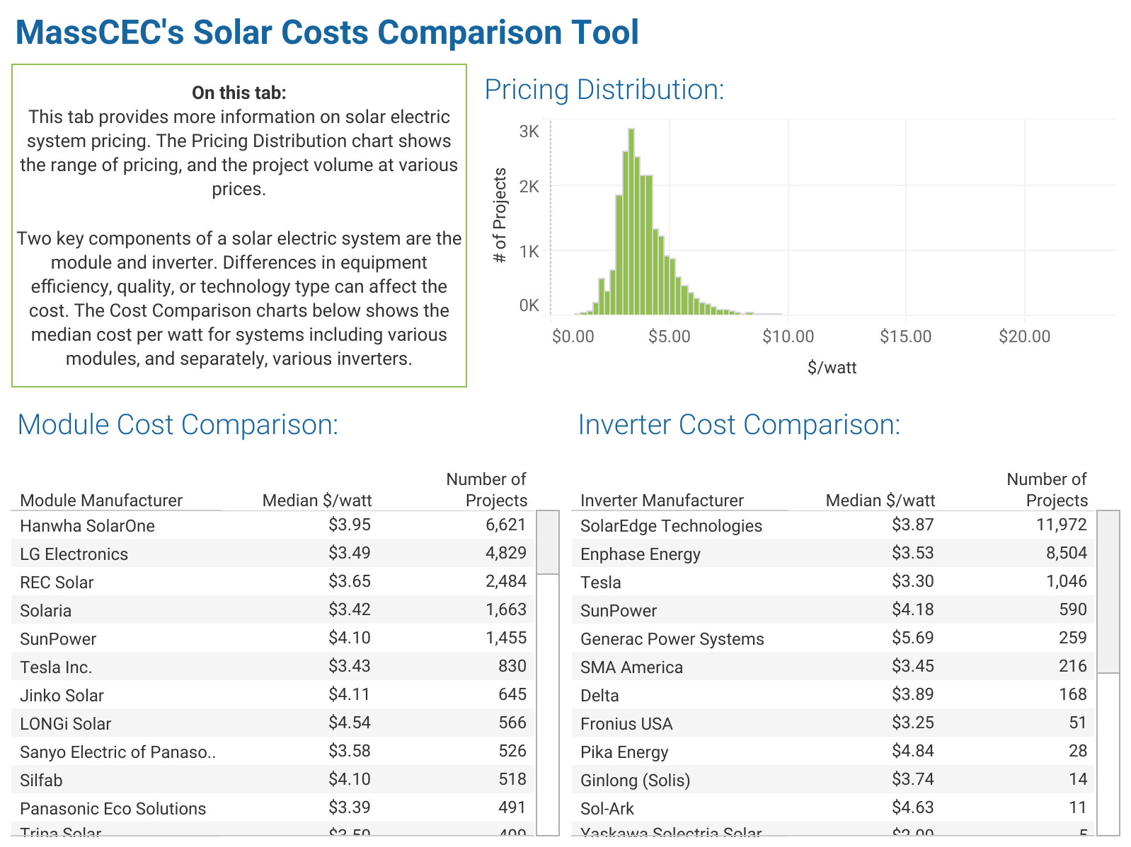

Slide 4
